Slide 1

2021 Update

Slide 2
Update on the SAFE Task Force
Asante Cain
City of Grand Rapids
Assistant to the City Manager
2
Notes:
Good morning City Commission. My name is Asante Cain and I am the liaison to the SAFE Task Force and I’m here today to give an update on the activities of the SAFE Task Force. The City of Grand Rapids established an anti-violence strategy in 2015 titled Safe Alliances For Everyone (SAFE). Since them many of the recommendations have been completed and
SAFE fosters meaningful partnerships with community organizations, businesses, public institutions, nonprofits and grassroots groups to limit violence in our community

Slide 3
Members of the SAFE Task Force
Carol Rienstra: President, Restorative Justice Coalition of West Michigan
Chris Becker: Kent County Prosecutor, Kent County
Deputy Chief Rifenberg: Grand Rapids Police Department
JD Chapman: Realism is Loyalty
Kerby Killingham: Seeking Safety, Family Outreach Center
Larry Johnson: Chief of staff/Assistant Superintendent and Executive Director of Public Safety, Grand Rapids Public Schools
Marian Berrera-Young: Crime Prevention Coordinator, Baxter Neighborhood Association
Milinda Ysasi, 2nd Ward Commissioner
Senita Lenear, 3rd Ward Commissioner
Shannon Harris: Interim Executive Director, Our Community’s Children
Staff Liaison- Asante Cain, Assistant to the City Manager, City of Grand Rapids
Notes:
community organizations
Businesses
public institutions
Nonprofits
grassroots groups and individuals
Cross functional

Slide 4




Gun Buyback
Two Gun Buybacks. Firearms were in good working condition. $34,482 was allocated for gift cards for the firearms
  Tier 1- Assault Rifles / Semi-Automatic Handguns - $200
  Tier 2- Revolvers / Shotguns / Rifles - $100
  Tier 3- Black Powder Firearms - $50
First event was held October 24, 2020 in the Third Ward. Second event held November 7, 2020 in the First Ward. First event awarded $14,000 in gift cards in 1.5 hours. Second event had similar success.
4

Slide 5
Gun Buyback
Date | Gun Tier 1 | Gun Tier 2 | Gun Tier 3 | Total Guns Disposed of
Oct. 24, 2020 | 39 | 66 | 2 | 107
Nov. 7, 2020 | 41 | 104 | 15 | 160
Totals for Entire Gun Buyback | 80 | 170 | 17 | 267
5

Slide 6


Parenting Program
Grants awarded to Family Outreach Center and Realism is Loyalty to address SAFE PEACE Pillar recommendations, specifically in the Prevention Investment strategy. Awarded programs are helping families address at least two of the following:
Create and set appropriate parent/child boundaries, interactions, and communication
Negotiate the “leaving home” stages of separation, independence, and re-connection
Process grieving, loss and trauma that often accompanies delinquent patterns of behavior
Specific techniques to resolve parent/youth conflicts in healthy ways;
Understand family patterns of interactions that are often repeated over generations
Better understand adolescent development
Strengthen familial and community support strategies that prevent severe behavioral and emotional problems
Promote healthy child and parent choices and activities that will enhance a better future.
6
Notes:
Grants awarded to Family Outreach Center and Realism is Loyalty to address SAFE PEACE Pillar recommendations, specifically in the Prevention Investment strategy. The SAFE Task Force sought to facilitate programs on practical living tools and mental health resources for parents and youth, aged 15-24. Parents are critical in the lives of youth and set the foundation for values and behaviors. When families struggle with the many stressors of daily life and for some, past abuses, healthy family relationships are often compromised. Awarded programs are helping families address at least two of the following:

Slide 7
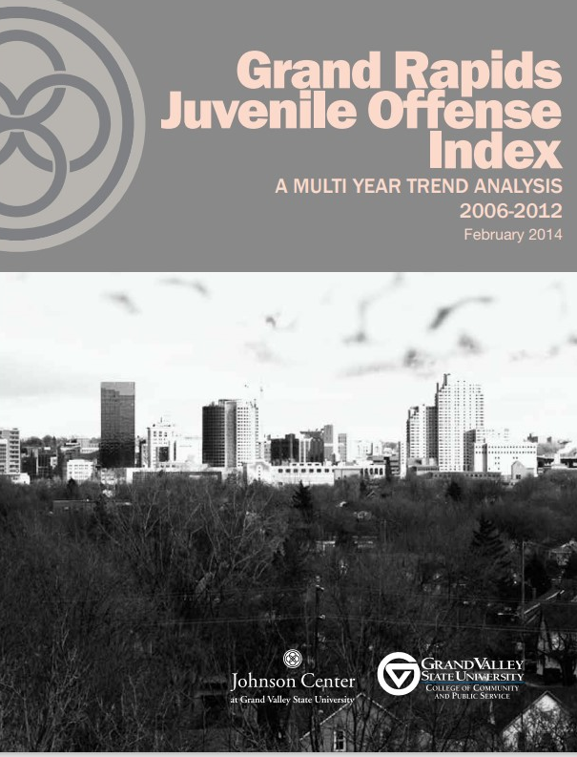
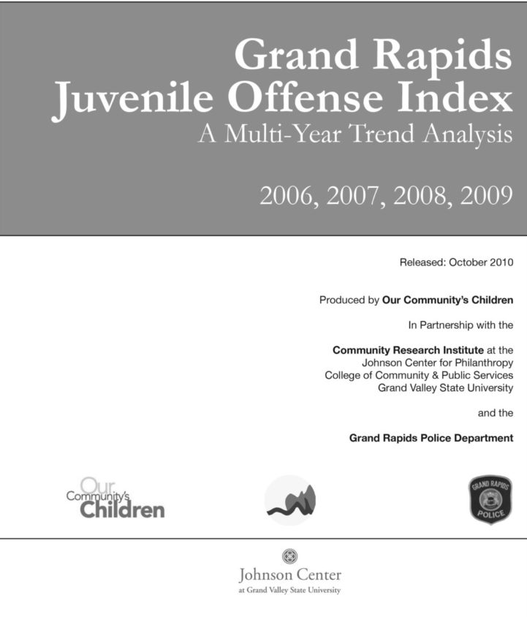
Update to Juvenile Offense Index
Beginning in 2010 and 2014 Our Community’s Children (OCC) – a partnership with the City of Grand Rapids and the Grand Rapids Public Schools, worked with evaluators at the Johnson Center at Grand Valley State University to analyze crime data for children and youth. At that time, OCC was facilitating the Expanded Learning Opportunities (ELO) Network, a community collaboration of over 60 agencies dedicated to ensuring that every child has access to quality afterschool programs. They were interested in understanding the importance of afterschool programs in the prevention of criminal offenses and wondered if the national trends of when offenses occur – immediately after the school day – were true for Grand Rapids.
The SAFE Task Force is working with the
Purchasing Department to prepare an RFP
to update that report using data
from the last 8 years.
7

Slide 8
Reviewing the Recommendations
The Task Force has been using the last few months to review the 2015 recommendations to find out which of the recommendations are most relevant to the state of violence in our community today.
8
Notes:
Some recommendations have been completed like body cams
Others the City has worked at hard in improving such as training regarding equity

Slide 9
SAFE Taskforce Investments- FY2021
Item Description | Amount
Parenting Program
Family Outreach Center | $ 24,999
Realism is Loyalty | $ 24,357
Gun Buyback
First Buyback | $ 14,857
Second Buyback | $ 20,482
Community Promotion and Partnerships with Neighborhood Associations | $ 6,880
Previous Pitch Night Obligations
Monroe Aki | $ 1,000
Neighbors of Belknap | $ 2,500
Total | $ 95,075
Unallocated Funds | $ 84,927
9

